Slide 1
Title: Object-Oriented Programming in Java
Subtitle: An Introduction to OOP Concepts in Java
Presented by :
Name : Pallavi Darade
Date : 05/11/2024

Slide 2
What is OOP?
Java is an Object-Oriented Language.
Object Oriented Programming
is amethodology to design a program using classes and objects. It simplifies thesoftware development and maintenance by providing some concepts:
•
Object
•
Class
•
Encapsulation
•
Inheritance
•
Polymorphism
•
Abstraction
2
Definition: Object-Oriented Programming is a programming paradigm based on the concept of objects.
Java is an Object-Oriented Language.
Object Oriented Programming is a methodology to design a program using classes and objects.

Slide 3
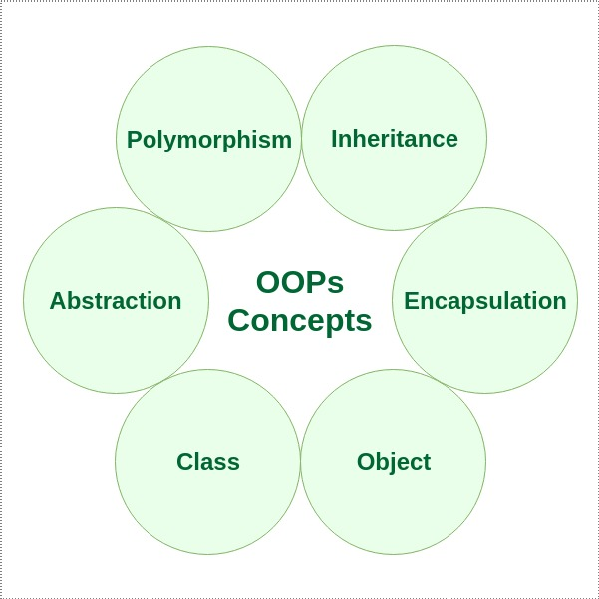
It simplifies the software development and maintenance by providing some concepts: Key Concepts of OOP:
Object
Class
Encapsulation
Inheritance
Polymorphism
Abstraction

Slide 4
Object: An instance of a class. Created using the new keyword.
Example:
Car myCar = new Car();
myCar.model = "Toyota";
myCar.year = 2021;
myCar.startEngine();

Slide 5
Class:
A class is a user-defined prototype from which objects are created. It represents the set of properties or methods that are common to all objects of one type. Using classes, you can create multiple objects with the same behavior instead of writing their code multiple times.
Example:
class Car
{
String model;
int year;
void startEngine()
{
System.out.println("Engine started");
}
}

Slide 6
Encapsulation:
It is defined as the wrapping up of data under a single unit. It is the mechanism that binds together the code and the data it manipulates.
In encapsulation, the data in a class is hidden from other classes, which is similar to what data-hiding does. So, the terms “encapsulation” and “data-hiding” are used interchangeably.

Slide 7
Inheritance
Definition:
Inheritance allows a class to inherit properties and behaviors
(methods) from another class.
A subclass (child class) inherits from a superclass (parent class).
Why Use It?
Code reusability.
Extends functionality without modifying the original class.

Slide 8
Polymorphism
Definition: Polymorphism means "many forms." It allows objects of different classes to be treated as objects of a common superclass.
Two types of polymorphism in Java:
Compile-time Polymorphism (Method Overloading)
Runtime Polymorphism (Method Overriding)

Slide 9
Abstraction
Definition: Abstraction is the process of hiding the implementation details and showing only the necessary features.
In Java, abstraction can be achieved using abstract classes and interfaces.

Slide 10
Conclusion
OOP is fundamental to Java programming.
Key concepts like Encapsulation, Inheritance, Polymorphism, and Abstraction help in building flexible, modular, and reusable code.
Java provides the necessary tools and syntax to implement these OOP principles effectively.

Slide 11
Thank You

